Slide 1
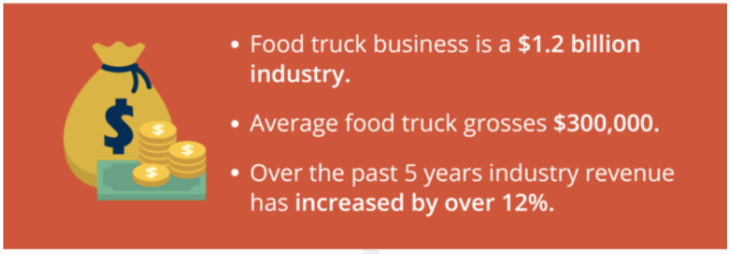
You have done your Industry Research
Business Model Design Copyright ©2020 Gregory G. Collier

Slide 2
E
EXAMPLE
Document Assumptions
Founder puts in $150,000 of retirement savings
Founder takes a loan of $200,000 from a Bank (4% Interest)
28% Tax Rate
15 days Inventory
15% Depreciation
Design and buy the Food Truck ($200,000) Capital
Ten sandwich machines are produced ($5K each) Capital
3 weeks Training (3 Weeks *6 Hours x 5 days * 5 People*$25/hr) Direct Labor
Training Prep Kitchen (Costs = $500/day) Other Purchases
Training food costs and 1st week inventory = $20,000 Direct Materials
Lawyer and Food Truck License ($9K) Legal fee
Miscellaneous Expense ($1K) Other Purchases
POS ($5k) Capital
Business Model Design Copyright ©2020 Gregory G. Collier

Slide 3
E
EXAMPLE
Document Assumptions
Quarterly Revenue
We will have 1 food truck for the year
The truck will operate 6 hours for 7 days a week
Average Ticket Price per customer is $10
Maximum Capacity units for the truck is 30 tickets per hour
Assume 91.25 days per quarter
Business Model Design Copyright ©2020 Gregory G. Collier

Slide 4
E
EXAMPLE
Document Assumptions
Quarterly Expense
Food Costs are 30% of Revenue
Packaging is $.15 per unit
Fuel for the truck is $1,500 per Quarter (6K annually) Other Purchases
Prep Kitchen Rent is $1,500 per month. and will be used 4 hours a day(18k annually) Other Purchases
Wages will be $25/hr. ($54,750 annually)
Founder and 3 employees work in the truck (All get paid)
One additional employee works in food prep for $54,750
Social Media Marketing expenses are Facebook ads ($3K/qtr) Yelp ($750/qtr) and Other Marketing (Flyers) ($300/qtr)
Business Model Design Copyright ©2020 Gregory G. Collier

